Slide 1
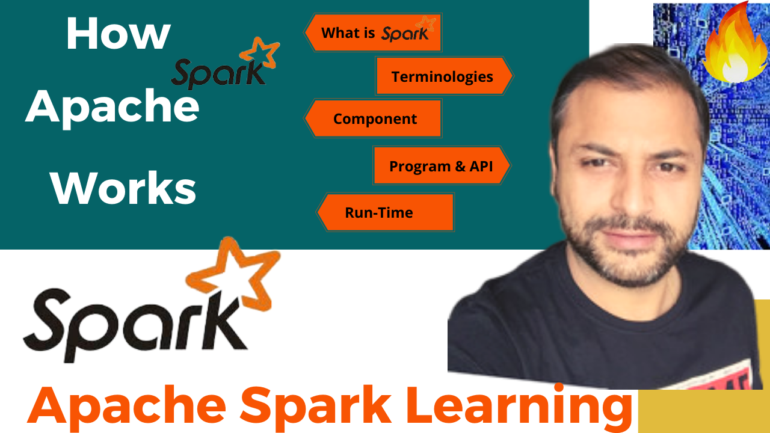


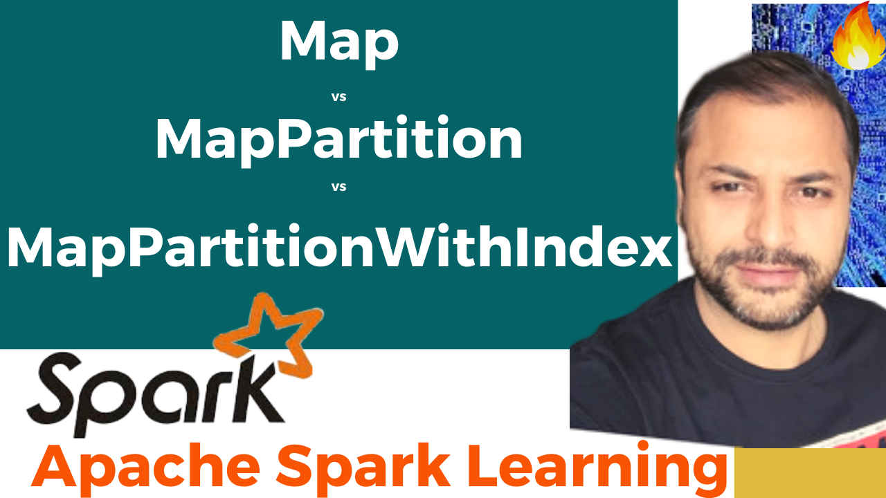


Partition Pruning
&
Predicate Pushdown
Interview Question

Slide 2

Map vs MapPartition vs MapPartitionWithIndex
map | mapPartition | mapPartitionWithIndex
Transformation | Transformation | Transformation
Works on a single Row at a time | Works on a partition at a time | Works on a partition at a time , along with retaining the index for the partitions
Returns after each Input Row | returns after processing all the Rows in the partition | returns after processing all the Rows in the partition
Doesn’t hold the output result in Memory | output is retained in memory, as it can return after processing all the rows in a particular partition | output is retained in memory, as it can return after processing all the rows in a particular partition

Slide 3
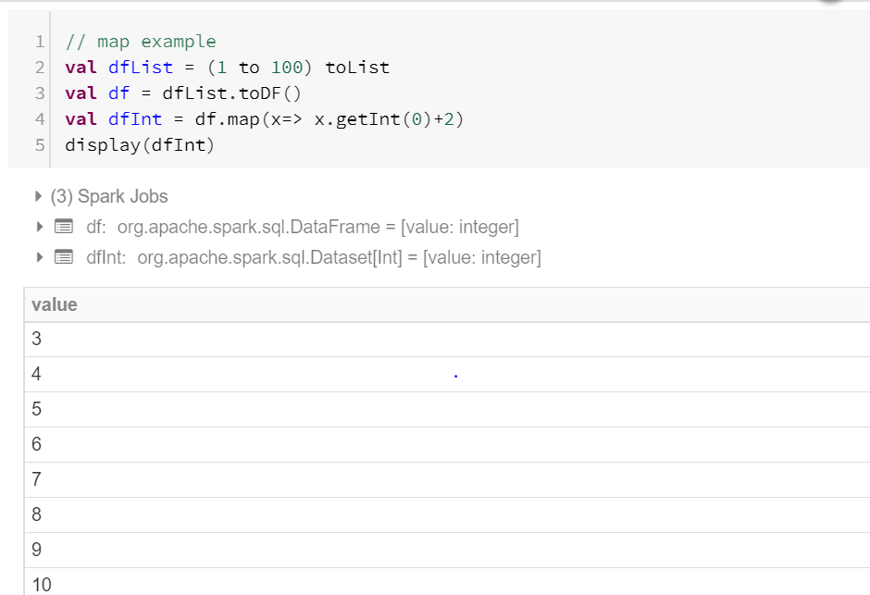
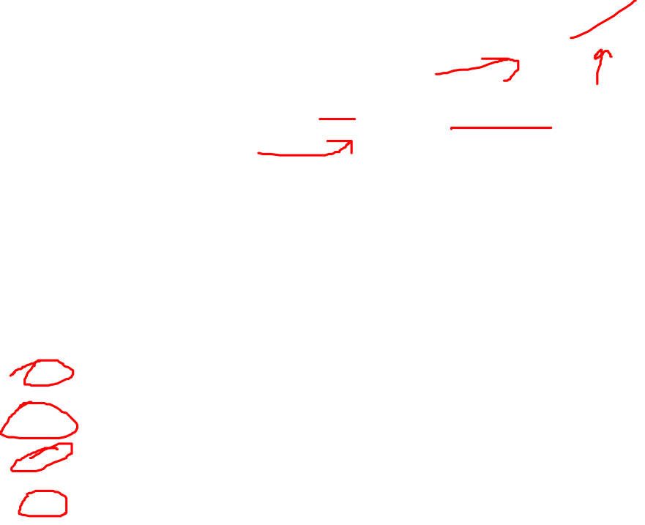
Example : map

Slide 4
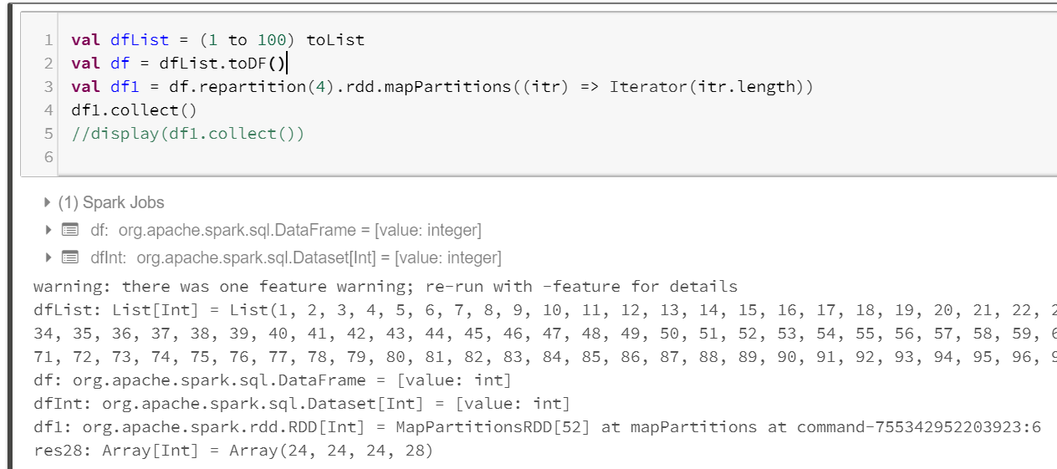

Example : MapPartition

Slide 5
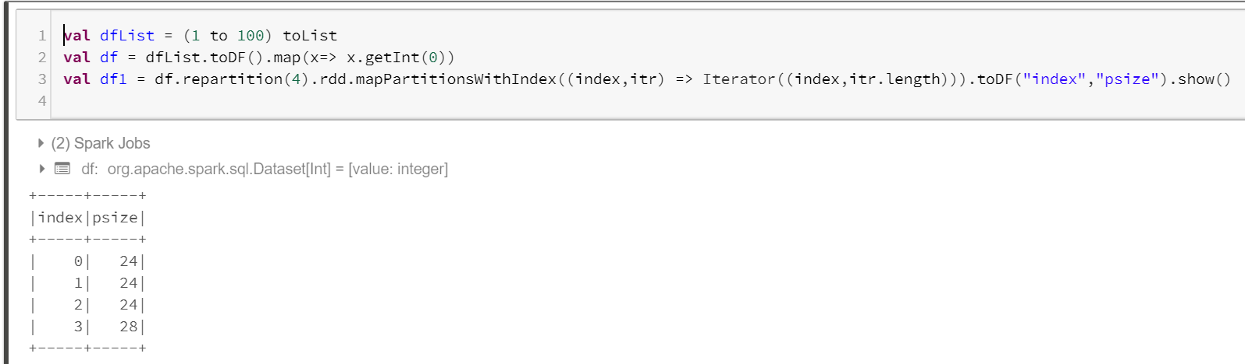

Example : MapPartitionWithIndex

Slide 6
Map vs MapPartition vs MapPartitionWithIndex
Thanks and do subscribe to my channel

